Slide 1
Growing Like China
Author: Zheng Song, Kjetil Storesletten, and Fabrizio Zilibotti
Presented by Shangli Chen
Instructed by Phil Dybvig

Slide 2
Overview
Introduction
Empirical Evidence
Theory & Modeling
Conclusion & Discussion

Slide 3
Introduction

Slide 4
Background
Over the last 30 years, China has undergone a spectacular economic transformation:
fast economic growth, sustained capital accumulation, major shifts in the sectoral composition of output, increased urbanization, a growing importance of markets and entrepreneurial skills.
The rate of return on investment has remained well above 20 percent
foreign reserves swelled from 21 billion USD in 1992 (5% of GDP) to 2,130 billion USD in June 2009 (46% of GDP)

Slide 5
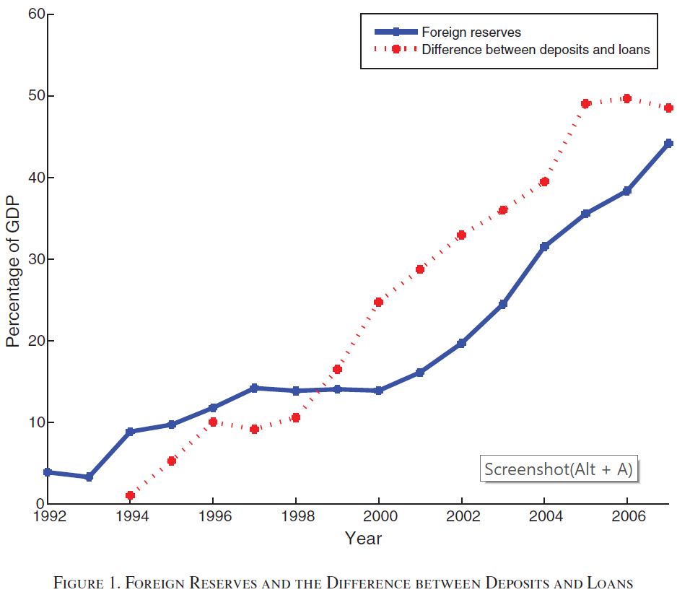
Background

Slide 6
Puzzle
Puzzle: the consistence of high growth, high return to capital and foreign surplus
A closed-economy neoclassical growth model predicts that the high investment rate would lead to a fall in the return to capital
An open-economy model predicts a large net capital inflow rather than an outflow, due to the high domestic return to capital

Slide 7
Theory
Focal points: Financial frictions & reallocation of resources across firms
Sustained return of capital and the foreign surplus arise from the reallocation of capital and labor from less productive externally financed firms to entrepreneurial firms that are more productive but have less access to external financing
Since the shrink of financially integrated firm, the increase in the investment of foreign assets lead to the foreign surplus
Notes:
The focal points of the theory are financial frictions and reallocation of resources across firms. In our theory, both the sustained return to capital and the foreign surplus arise from the reallocation of capital and labor from less productive externally financed firms to entrepreneurial firms that are more productive but have less access to external financing. As financially integrated firms shrink, a larger proportion of the domestic savings is invested in foreign assets. Thus, the combination of high growth and high investment is consistent with the accumulation of a foreign surplus.

Slide 8
Theory
The theory yields several predictions consistent with the evidence of China’s transition:
The theory predicts that the surplus—savings minus investment—should increase with the share of entrepreneurial firms
In the benchmark model, all firms produce the same good and differ only in TFP. We extend the theory to a two-sector model in which firms can specialize in the production of more or less capital-intensive goods
Notes:
Consistent with this prediction, we find that the net surplus is significantly higher in Chinese provinces
in which the employment share of domestic private firms has increased faster.
We extend the theory to a two-sector model in which firms can specialize in the production of more or less capital-intensive goods. This extended
model predicts that financially constrained firms with high TFP will specialize in labor-intensive activities (even though they have no technological comparative
advantage). Thus, the transition proceeds in stages: first low productivity firms retreat into capital-intensive industries, and then they
gradually vanish. This is consistent with the observed dynamics of sectoral reallocation in China, where young high-productivity private firms have
entered extensively in labor-intensive sectors, while old state-owned firms continue to dominate capital-intensive industries.

Slide 9
Empirical Evidence

Slide 10
Political Events and Macroeconomic Trends
Political Events:
First economic reforms in December 1978
New stage of the reform process was launched in 1992, after Deng Xiaoping’s Southern Tour
Macroeconomic Trends:
High investment rate, increasing return to capital in manufacturing
High corporate returns have not been matched by the return on financial assets available to individual savers
Falling labor share of aggregate output
Notes:
First economic reforms in December 1978: reduced land collectivization, increased the role of local governments and communities, and experimented with market reforms in a few selected areas.
The focus of this paper is on the post-1992 Chinese transition, a period characterized by fast and stable growth and by a pronounced resource reallocation within the manufacturing sector. In spite of very high investment rates (39 percent on average), the rate of return to capital has remained stable: while the aggregate return to capital has fallen slightly (from 28 percent in 1993 to 21 percent in 2005), the rate of return to capital in manufacturing has been increasing since the early 1990s and climbed close to 35 percent in 2003. High corporate returns have not been matched by the return on financial assets available to individual savers: the average real rate of return on bank deposits, the main financial investment of Chinese households, was close to zero during the same period. Wage growth has been lower than growth in output per capita
in recent years. Similarly, the labor share of aggregate output fell gradually from59 percent in 1998 to 47 percent in 2007 The falling labor share has contributed to rising inequality even across urban households

Slide 11
Reallocation in Manufacturing
The Evolution of the employment share of private enterprises
All measures suggest that the share of DPE (Domestic Private Enterprise) was low until 1997 and that most of the transition took place thereafter
Notes:
The reallocation of capital and labor within the manufacturing sector is a focal point of our paper. Figure plots alternative measures of the evolution of the employment share of private enterprises. Our preferred measure is based on annual firm-level surveys conducted by China’s National Bureau of Statistics (NBS), which include the universe of Chinese industrial firms (manufacturing, mining, and construction) with sales over 5 million RMB. The solid line plots the proportion of domestic private enterprises (DPE) as a percent of DPE plus state-owned enterprises (SOE) in the NBS surveys. It shows an increase from 4 percent in 1998 to 56 percent in 2007. This is the most relevant measure for our theory.4 However, it excludes two important firm categories: foreign enterprises (FE) and collectively owned enterprises (COE). Therefore, for completeness, we also report a broader measure of the private employment share, namely, (DPE+FE)/(DPE+FE+SOE+COE); see the dashed line. All measures suggest that the share of DPE was low until 1997 and that most of the transition took place thereafter. This accords well with the political events outlined above.

Slide 12
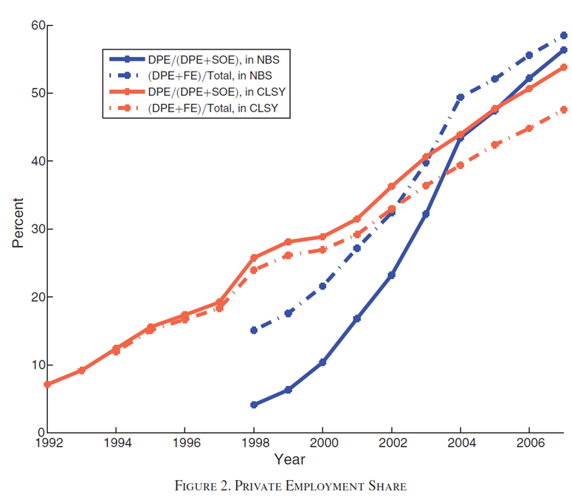
Reallocation in Manufacturing

Slide 13
Productivity and Credit Frictions
DPE (Domestic Private Enterprise) and SOE (State-Owned Enterprise) differ in two important aspects: productivity and access to financial markets
DPE are, on average , more productive than do SOE:
DPE’s ratio of total profits to fixed assets net to depreciation is about 9% higher than SOE per year since 1997
DPE are financially repressed:
Discrimination in credit markets
Both capital-output and capital-labor ratios are substantially lower in DPE than in SOE
Notes:
SOE are, on average, less productive and have better access to external credit than do DPE.
China scores poorly in terms of creditor rights, investor protection, accounting standards, nonperforming loans, and corruption.
In this environment, Chinese firms must rely heavily on retained earnings to finance investments and operational costs. Financial repression is far from uniform: private firms are subject to strong discrimination in credit markets. The Chinese banks—mostly state owned—tend to offer easier credit to SOE

Slide 14
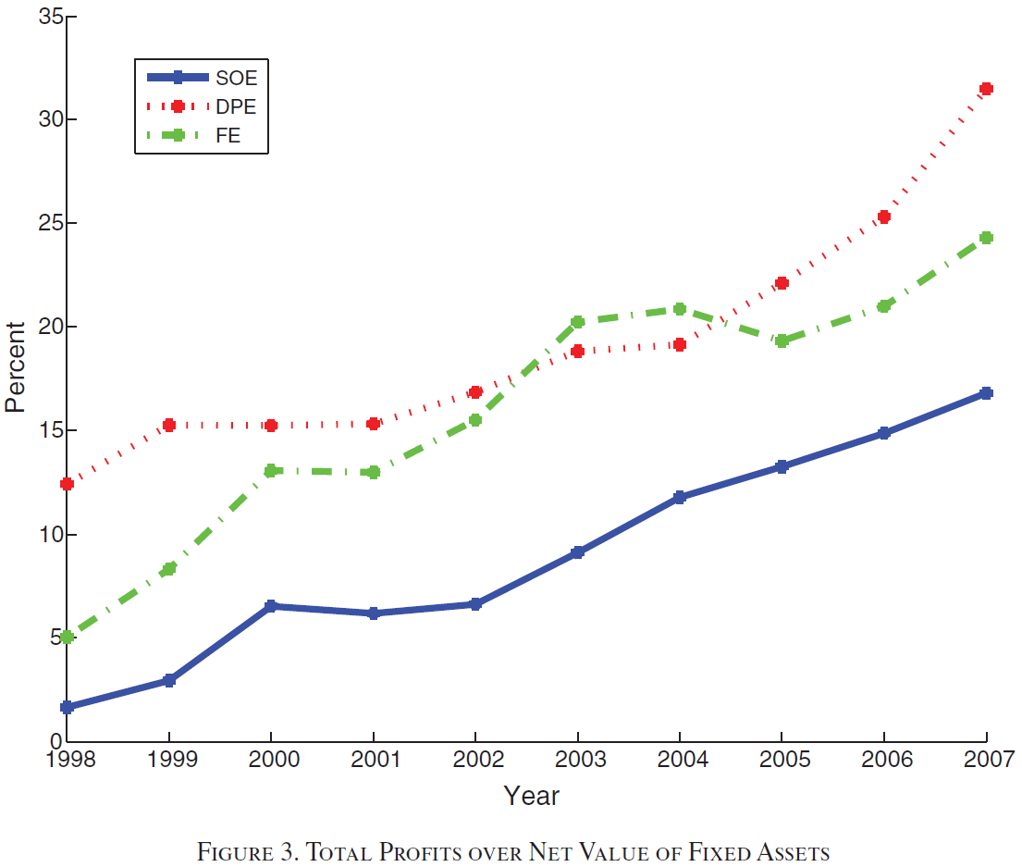
Productivity and Credit Frictions

Slide 15
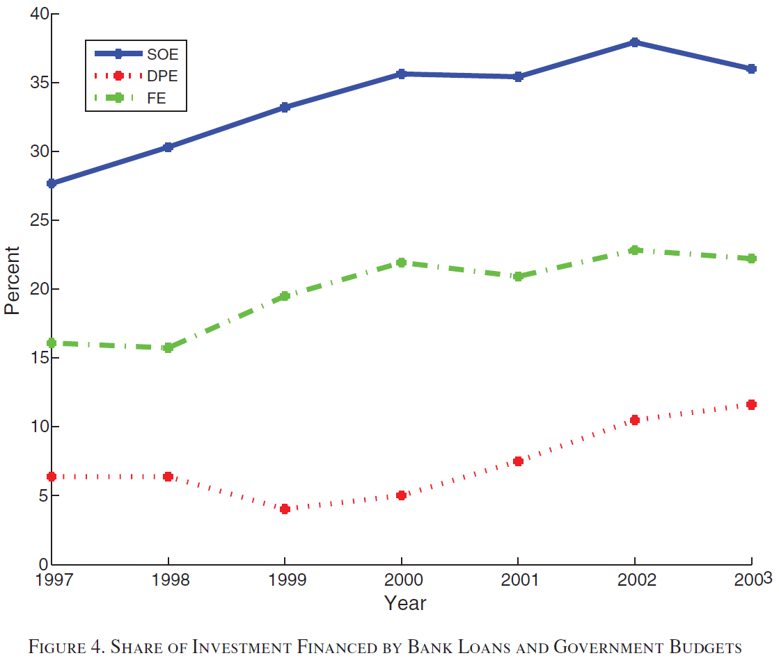
Productivity and Credit Frictions

Slide 16
Income Inequality
The economic transition of China has been accompanied by increasing income inequality
the Gini coefficient of income in China grew from 0.36 in 1992 to 0.47 in 2004.
Notes:
Our theory suggests that this development may be due in part to the slow growth of wages relative to entrepreneurial income. The pattern of income inequality across regions can offer some insight. We classify Chinese provinces by the percentage of industrial workers who are employed in DPE. Figure 6 shows a high positive correlation between the Gini coefficient at the provincial level in 2006 and the employment share of DPE: provinces with more private firms have a substantially higher income dispersion.

Slide 17
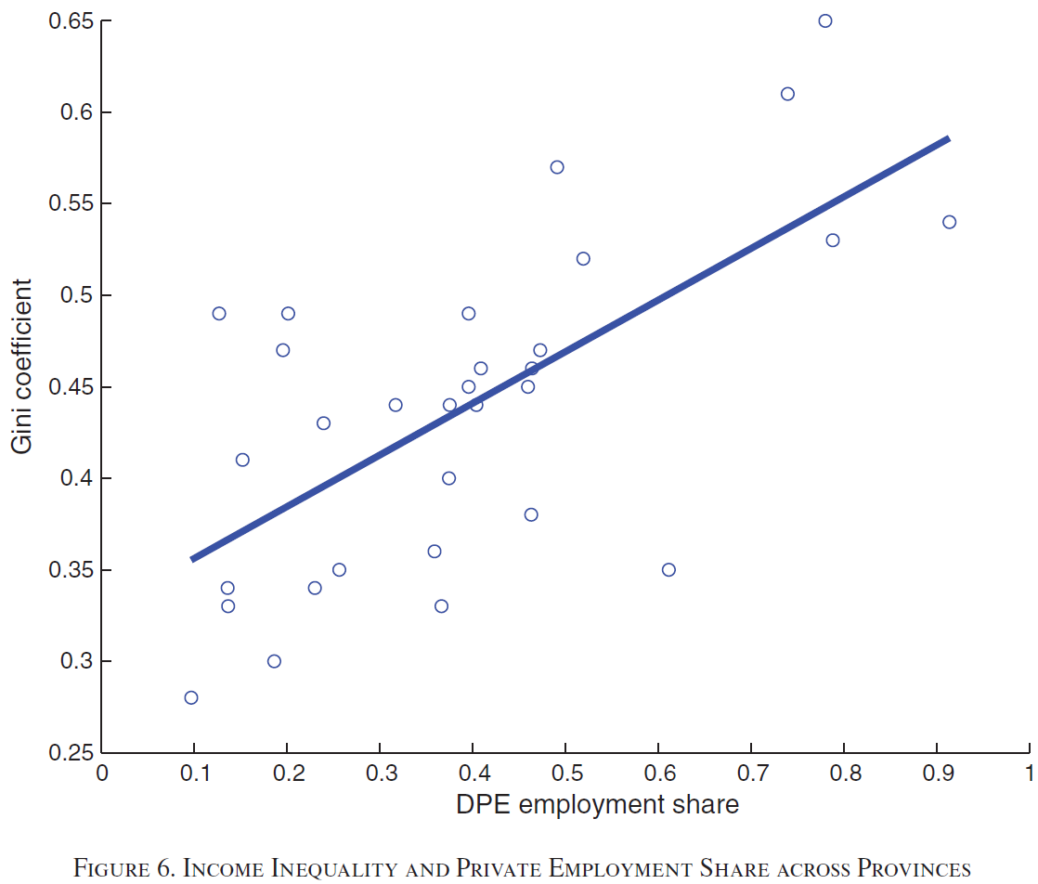
Income Inequality

Slide 18
Foreign Surplus and Productivity Growth
The timing of structural change from SOE to DPE follows quite closely that of the accumulation of foreign reserves: Both accelerate around year 2000
The breakdown of the net surplus (savings minus investment) across provinces suggests the same pattern in the cross section: the net surplus is systematically larger in provinces with a larger increase in the DPE employment share
Notes:
the reallocation process in manufacturing has an interesting statistical relationship with the accumulation of a foreign surplus and the productivity growth.
Consider, first, the foreign surplus.

Slide 19
Theory & Modeling

Slide 20
Model & Key Assumption
Financially integrated (F) firms are owned by intermediaries (to be defined below) and operate as standard neoclassical firms.
Entrepreneurial (E) firms are owned by old entrepreneurs. The entrepreneurs are residual claimants on the profits and hire their own children as managers
F firms have access to the deep pockets of banks, which are perfectly integrated in international financial markets
E firms are owned by agents who have superior skills and can run more productive technologies. However, they are credit constrained
Notes:
a country starts from a situation of severe inefficiency, but manages to ignite the engine of reallocation, it has the potential to grow fast
over a prolonged transition. The mechanism is like that of models of transition from agriculture to industry: efficient firms can count on a highly elastic supply of factors attracted from the less productive firms.
To analyze such a transition, we construct a model in which firms are heterogeneous in productivity and access to financial markets. High-productivity firms are
operated by agents with entrepreneurial skills who are financially constrained and who must rely on retained earnings to finance their investments. Low-productivity firms can survive due to their better access to credit markets, since the growth potential of high-productivity firms is limited by the extent of entrepreneurial savings. If the saving flow is sufficiently large, high-productivity firms outgrow low-productivity ones, progressively driving them out of the market. During the transition, the dynamic equilibrium has AK features: within each type of firm, the rate of return to capital is constant due to labor mobility and to the financial integration of the low productivity firms. Due to a composition effect, the aggregate rate of return to capital actually increases. Moreover, the economy accumulates a foreign surplus. While investments in the expanding firms are financed by the retained earnings of entrepreneurs,
wage earners deposit their savings with intermediaries who can invest them in loans to domestic firms and in foreign bonds. As the demand for funds from
financially integrated domestic firms declines, a growing share of the intermediated funds must be invested abroad, building a growing foreign surplus. This prediction is consistent with the observation that the difference between deposits and domestic bank loans has been growing substantially, tracking China’s accumulation of foreign reserves (see again Figure 1).

Slide 21
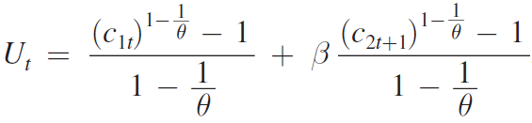
Preference
Preferences are parameterized by the following time-separable utility function:
Β: discount factor
Ct: consumption
θ: intertemporal elasticity of substitution
Notes:
The model economy is populated by overlapping generations of two-period lived agents who work in the first period and live off savings in the second period.
Preferences are parameterized by the following time-separable utility function:
where β is the discount factor and θ is the intertemporal elasticity of substitution in consumption c t . We focus on the case when agents’ savings are nondecreasing in the rate of return, i.e., when θ ≥ 1.

Slide 22
Technology
The technology of F and E firms are described, respectively, by the following production functions:
Notes:
where y is output and k and n denote capital and labor, respectively. Capital depreciates fully after one period. In the case of F firms, the input of the manager is equivalent to that of a regular worker and is included in n F . The technology parameter A grows at an exogenous rate z; A t+1 = (1 + z) A t .

Slide 23

Foreign Surplus, Savings, and Investments
The country’s foreign surplus is given by:
Notes:
As long as the employment share of the E firms ( N Et / N t ) increases during the transition, the country’s foreign surplus per efficiency unit, B t /( A t N t ), increases. When the transition is completed (in period T, say) and all workers are employed by E firms ( N ET / N T = 1), the net foreign surplus becomes B T = ( ζ W (1 − α) κ Fα −1 /((1 + z)(1 + ν)) − η) κ Fα AT N T . If E firms are sufficiently credit constrained (i.e., if η is low), then the transition necessarily ends with a positive net foreign position.
The intuition for the growing foreign surplus is that as employment is reallocated towards the more productive E firms, investment in the financially integrated F firms shrinks. Hence, the demand for domestic borrowing falls and banks must shift their portfolio towards foreign bonds.
Next, consider the country’s investment. Suppose, for simplicity, that z = ν = 0. Then every worker who is shifted from an F firm to an E firm works with less
capital. Therefore, domestic investment falls during the transition

Slide 24
Financial Development
Incorporate financial development into our theory by letting the iceberg intermediation cost, ξ, fall over time, causing a decrease in the lending rate R t l = R/ (1 − ξ t ) . Ceteris paribus, a reduction in ξ and R t l pushes up wages and capital- labor ratios in both E and F firms. The reduction in ξ over time can offset the tendency for the investment rate to fall (and for the average rate of return to increase).
Notes:
In Section IID, we noted that the theory predicts falling investment rates during the transition. Different from a standard neoclassical growth model, the investment rate does not fall in our theory because of capital deepening bringing about decreasing returns. Rather, the fall is due to a composition effect: financially constrained firms—which have a lower capital-output ratio—expand, while financially unconstrained firms' contract. However, in the Chinese experience there is no evidence of a falling investment rate
We incorporate financial development into our theory by letting the iceberg
intermediation cost, ξ, fall over time, causing a decrease in the lending rate
R t l = R/ (1 − ξ t ) . Ceteris paribus, a reduction in ξ and R t l pushes up wages and capital-
labor ratios in both E and F firms. The reduction in ξ over time can offset the tendency
for the investment rate to fall (and for the average rate of return to increase).
Such for of financial development slows transition via two channels: (i) it increases
wages, which in turn strengthens the comparative advantage of F firms—entrepreneurs
must save more to attract workers from F firms—and (ii) it reduces ρ E and the
saving rate of entrepreneurs.26 We will return to the effects of financial development
in the next section.

Slide 25
Conclusion & Discussion

Slide 26
Discussion of Results
Despite the high investment and growth of industrial production, the rate of return of firms does not fall
E firms—similarly to DPE in China—have a higher TFP and less access to external financing than other firms
The rate of return to capital is higher in E firms than in F firms
The transition is characterized by factor reallocation from financially integrated firms to entrepreneurial firms
The reallocation leads to an external imbalance — as in the data, the economy runs a sustained foreign surplus
The model predicts a growing inequality between workers’ wages and entrepreneurial earnings.
Notes:
Our theory fits some salient features of the recent Chinese growth experience discussed in Section I. First, in spite of the high investment and growth of industrial
production, the rate of return of firms does not fall. Second, E firms—similarly to DPE in China—have a higher TFP and less access to external financing than other firms. This induces a lower capital intensity in E firms than in F firms (Lemma 1)— again in line with the empirical evidence. Moreover, the rate of return to capital is higher in E firms than in F firms, just as in the data DPE are more profitable than SOE. Third, the transition is characterized by factor reallocation from financially integrated firms to entrepreneurial firms, which is similar to the reallocation from SOE to DPE in the data. Fourth, such reallocation leads to an external imbalance— as in the data, the economy runs a sustained foreign surplus. Finally, the model predicts a growing inequality between workers’ wages and entrepreneurial earnings.

Slide 27
Conclusion
In this paper, they have constructed a neoclassical model augmented with financial and contractual imperfections that affect different types of firms in the economy asymmetrically
They have provided substantial empirical evidence corroborating the economic mechanism of an alternative theory that explains the build-up of a large foreign surplus in China as the outcome of structural imperfections

Slide 28
Discussion
How is it that China grows at such a stellar rate and at the same time increases its foreign surplus?
Some commentators have tried to explain this puzzle by attributing it to government manipulation of the exchange rate that holds the value of the Chinese currency artificially low
Notes:
This argument is controversial, as it attributes a long-standing imbalance to a nominal rigidity, without explaining why the peg of the nominal
exchange rate did not trigger an adjustment of the real exchange rate through inflationary pressure

Slide 29
Thank you !
Presented by Shangli Chen
Instructed by Phil Dybvig

